Slide 1
Network Media
Topic 6B

Slide 2
Learning Outcomes
By the end of this lesson, you should be able to:
Define the primary cables used in wired networking
Describe the characteristics of the major types of fiber-optic media
Explain the technologies used for wireless networking

Slide 3
Wired Networking
Wired networking uses tangible physical media called “cables”
Two broad categories of cables are copper wire and fiber optic
The main differences between the two types:
Composition of signals (electricity or light)
Speed at which signals can be sent
Distance the signals can effectively travel

Slide 4
Criteria for Choosing Network Media
Bandwidth Rating
Bandwidth is the number of bits per second that can be transmitted across a medium
A factor determining bandwidth is how bit signals are represented on the medium (called encoding)
When possible, choose a cabling category that’s compatible with the standard you want to implement now but will support growth and faster speeds
Maximum Segment Length
A cable segment is a length of cable between two network devices
Intermediate passive devices, such as wall jacks, are considered part of the total segment length
Each cable type can transport data only so far before its signals begin to weaken beyond what can be read by a receiving device (called attenuation)

Slide 5
Criteria for Choosing Network Media
Interference and Eavesdropping Susceptibility
Interference to electrical signals on copper media comes in the form of electromagnetic interference (EMI) and radio frequency interference (RFI)
Motors, transformers, fluorescent lights and other sources of intense electrical activity can emit both EMI and RFI.
RFI can also affect wireless networks if the frequencies are in the same range
Crosstalk is interference one wire generates on another wire when both wires are in a bundle
Copper wire is susceptible to electronic eavesdropping
Fiber-optic media carries light signals and is not susceptible to interference or eavesdropping

Slide 6
Criteria for Choosing Network Media
Cable Grade
Building and fire codes include specific cabling requirements
Cables ran between a false ceiling and the true ceiling (plenum) must be plenum-rated
UTP cabling is marked as communications riser (CMR) or communications plenum (CMP)
CMR can only be used for building risers or in cable trays
CMP is suitable for use in plenum spaces
Connection Hardware
Every type of cable has connectors that influence the kinds of hardware the cable can connect to
You must make sure the media you select can be supported by the network device

Slide 7
Criteria for Choosing Network Media
Other Media Considerations
Ease of installation – factors to consider:
Media’s minimum bend radius, which limits the angle at which a cable can be bent to run around corners
Cost and time needed to terminate the medium
Physical environment – types of walls and ceilings, EMI or RFI
Testability – A network that “works” might be crippled by excessive errors
It is important to certify whether the cable meets requirements for its category
Total cost – includes cabling, connectors, termination panels, wall jacks, termination tools, testing equipment and time

Slide 8
Coaxial Cable
Coaxial cable is often called “coax” for short
Once was the predominant form of network cabling
Inexpensive and easy to install
Coax started to phase out in the early 1990’s
Today, coaxial cable is used primarily in connecting a cable modem to the wall outlet your cable TV/Internet provider installs

Slide 9
Twisted-Pair Cable
Twisted-pair (TP) cable comes in two types: unshielded and shielded (UTP and STP)
TP consists of one or more pairs of insulated strands of copper wires twisted around one another and housed in an outer jacket
Twists are necessary to improve resistance to crosstalk from wires and EMI from outside sources
The more twists per unit length, the better resistance to EMI and crosstalk
More expensive TP is twisted more than less expensive and provides a better pathway for higher bandwidth networks

Slide 10
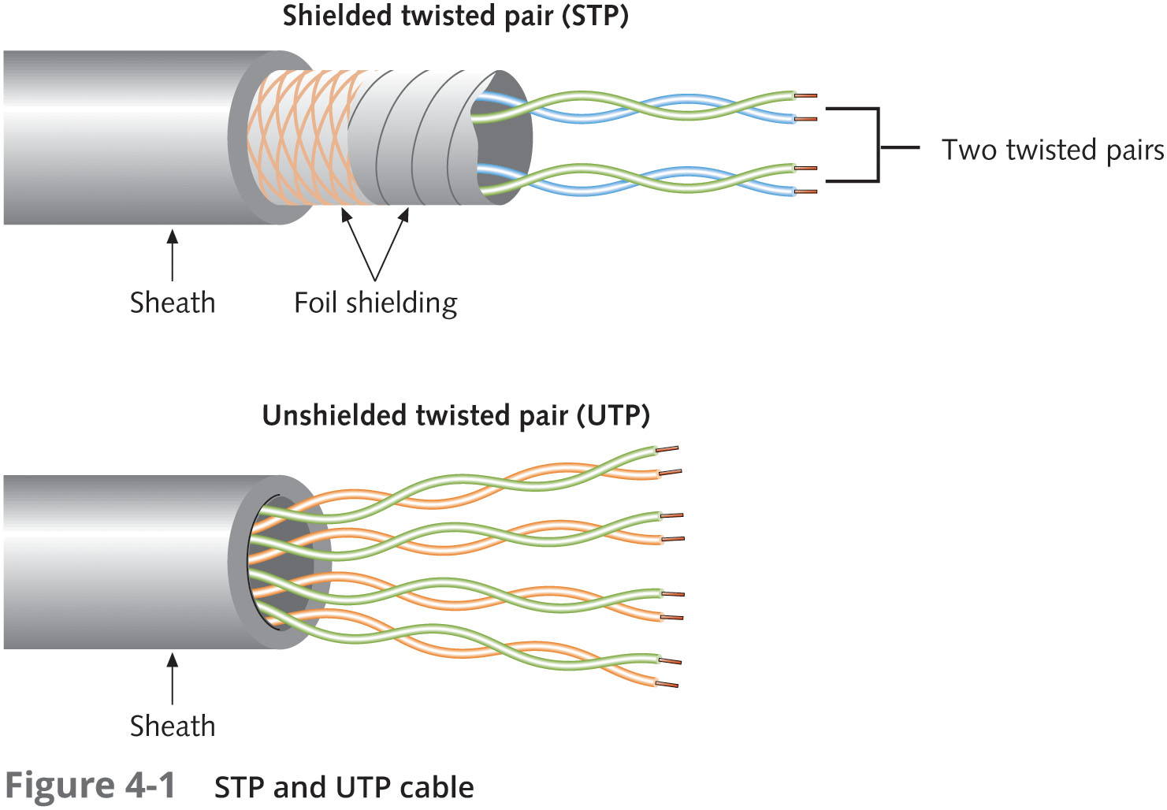
Twisted-Pair Cable

Slide 11
Twisted-Pair Cable
Unshielded Twisted-Pair Cable
Most networks use Unshielded Twisted-Pair (UTP)
UTP consists of four pairs of insulated wires
It is rated according to categories devised by the Telecommunications Industry Association (TIA) and Electronic Industries Alliance (EIA) and American National Standards Institutes (ANSI)
Categories 1 – 6a and Category 8 are accepted in US
Two additional categories aren’t yet TIA/EIA standards and might never be in US
Europe has accepted Category 7 and 7a, which specify that each wire pair is shielded
Categories 5e and 6 are the most installed categories of UTP cabling
Table 4-2 on the following slide shows Cat 5e and 6 UTP cabling characteristics

Slide 12
Twisted-Pair Cable
Characteristic | Value
Maximum cable length | 100 m (328 ft)
Bandwidth | Up to 1000 Mbps
Bend radius | Minimum four times the cable diameter or 1 inch
Installation and maintenance | Easy to install, no need to reroute; the most flexible
Cost | Least expensive of all cabling options
Connector type | RJ-45 plug, RJ-45 jack, and patch panels
Security | Moderately susceptible to eavesdropping
Signaling rates | 100 MHz for Cat 5e; 250 MHz for Cat 6
Interference rating | Susceptible to EMI and crosstalk

Slide 13
Twisted-Pair Cable
Shielded Twisted-Pair Cable
STP includes shielding to reduce crosstalk and interference
STP has a wire braid inside the sheath material or a foil wrap
It is best to use STP in electrically noisy environments or for very high-bandwidth applications
STP versions Cat 5e, Cat 6, and Cat 6a
Sometimes referred to as “foiled twisted pair (FTP)”

Slide 14
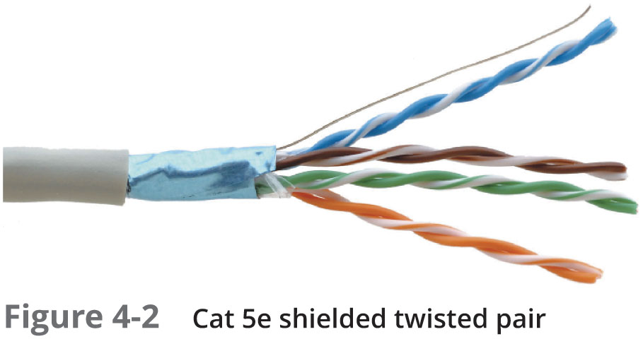
Twisted-Pair Cable

Slide 15
Twisted-Pair Cable
Twisted-Pair Cable Plant Components
RJ-45 Connectors – most STP and UTP cabling uses registered jack 45 (RJ-45)
RJ-45 connectors are most commonly used in patch cables, which are used to connect computers to hubs, switches, and RJ-45 wall jacks
Patch cable – short cable for connecting a computer to an RJ-45 wall jack or connecting a patch-panel port to a switch or hub
Can be made with inexpensive tools, two RJ-45 plugs and a length of TP cable
RJ-45 jacks – an RJ-45 jack is what you plug an RJ-45 connector into when the computer is in a work area away from hubs and switches
RJ-45 jacks are usually placed behind wall plates when cables are run inside walls but can be recessed into the floor or placed in surface-mounted boxes

Slide 16
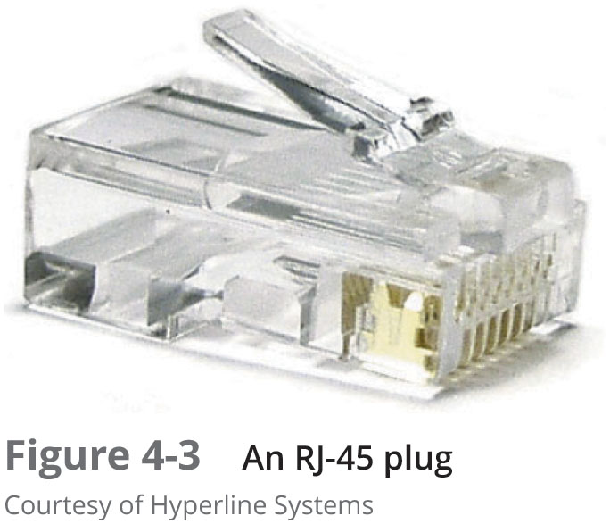
Twisted-Pair Cable

Slide 17
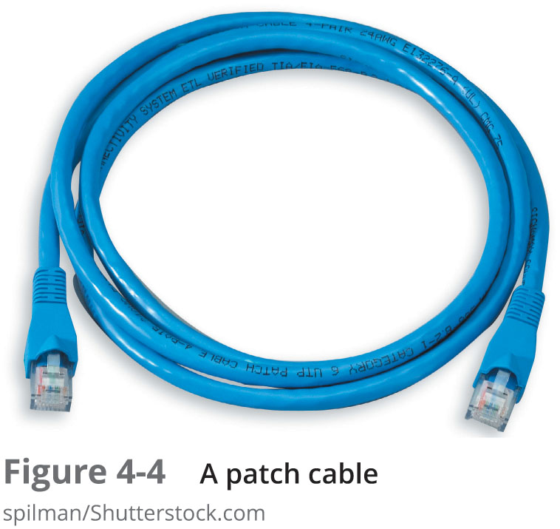
Twisted-Pair Cable

Slide 18
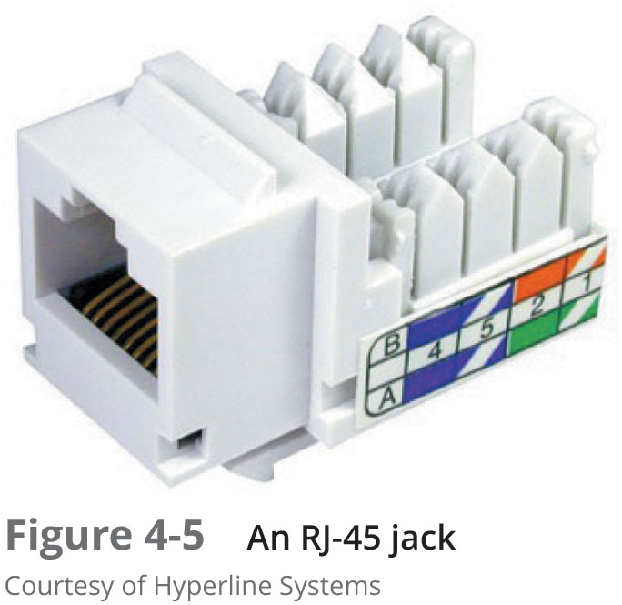
Twisted-Pair Cable

Slide 19
Twisted-Pair Cable
Twisted-Pair Cable Plant Components (continued)
Patch Panels – used to terminate long runs of cable from where the computers are to the wiring closet (where the switches and hubs are)
Distribution racks – hold network equipment such as routers and switches, plus patch panels and rack-mounted servers
Also called 19” racks because the upright rails are 19” apart

Slide 20
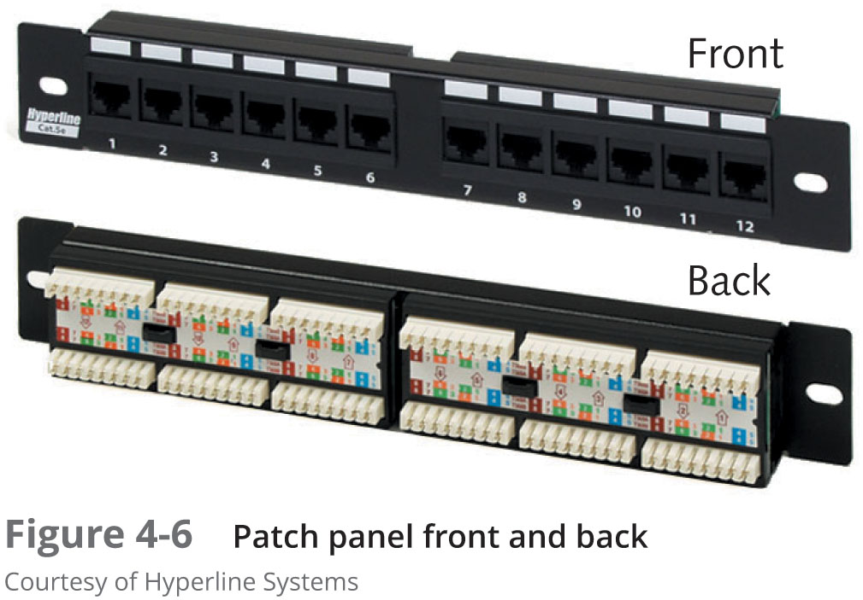
Twisted-Pair Cable

Slide 21
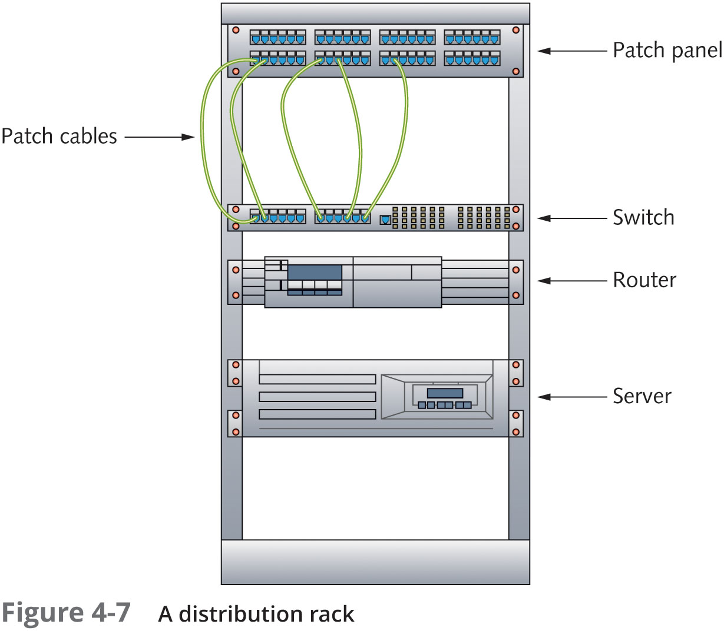
Twisted-Pair Cable

Slide 22
Structured Cabling: Managing and Installing a UTP Cable Plant
Structured cabling specifies how cabling should be organized, regardless of the media type or network architecture
Large networks typically use most or all of these:
Work area
Horizontal wiring
Telecommunication closets
Equipment rooms
Backbone or vertical wiring
Entrance facilities

Slide 23
Structured Cabling: Managing and Installing a UTP Cable Plant
Work Area
The work area is where workstations and other user devices are located
Faceplates and wall jacks are installed in the work area
Patch cables connect computers and printers to wall jacks
Horizontal Wiring
Horizontal wiring runs from the work area’s wall jack to the telecommunication closet
Wiring from the wall jack to the patch panel should be no longer than 90 meters (plus 10 meters for patch cables)

Slide 24
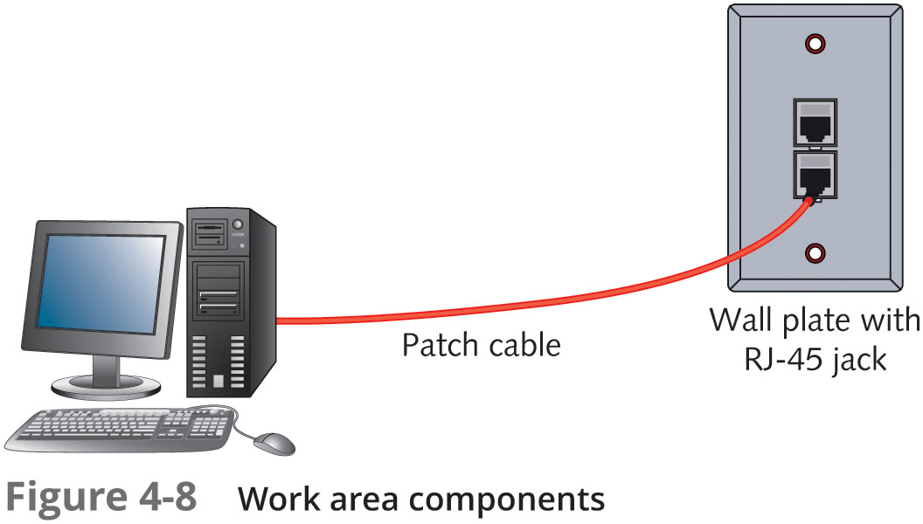
Structured Cabling: Managing and Installing a UTP Cable Plant

Slide 25
Structured Cabling: Managing and Installing a UTP Cable Plant
Telecommunications Closet
The telecommunications closet (TC) provides connectivity to computer equipment in the nearby work area
Typical equipment includes patch panels to terminate horizontal wiring runs, hubs and switches
A TC that houses the cabling and devices for work area computers is referred to as an intermediate distribution frame (IDF)

Slide 26
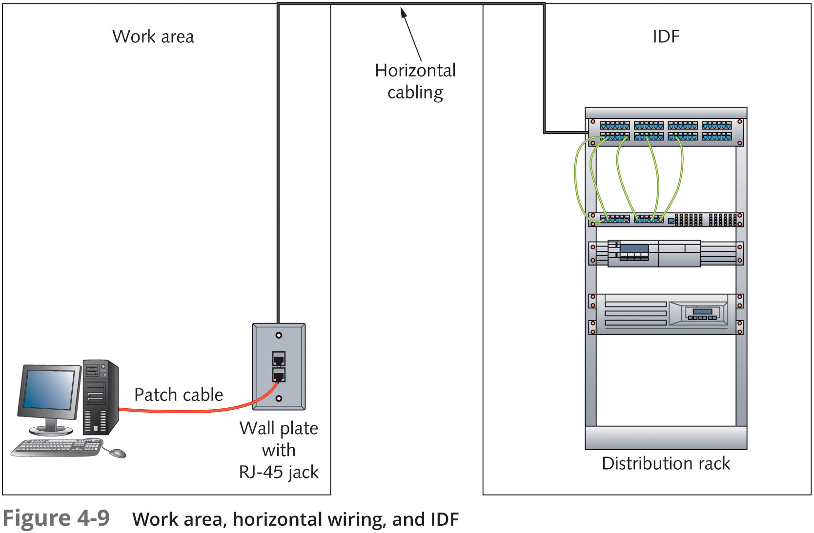
Structured Cabling: Managing and Installing a UTP Cable Plant

Slide 27
Structured Cabling: Managing and Installing a UTP Cable Plant
Equipment Rooms
The equipment room houses servers, routers, switches, and other major network equipment and serves as a connection point for backbone cabling
An equipment room that’s the connection point between IDFs is called a main distribution frame (MDF) or “main cross-connect”
An MDF can be the main cross-connect for the entire network or it might serve as the connecting point for backbone cabling between buildings
Each building often has its own MDF

Slide 28
Structured Cabling: Managing and Installing a UTP Cable Plant
Backbone Cabling
Backbone cabling interconnects IDFs and MDFs
This cabling runs between floors or wings of a building and between buildings
It is often fiber-optic cable but can also be UTP if the distance between TCs is less than 90 meters
Entrance Facility
Entrance Facility is the location of the cabling and equipment that connects a corporate network to a third-party telecommunications provider
It can also serve as an equipment room and the main cross-connect for all backbone cabling
Also where a connection to a WAN is made
Demarcation point is the point where corporate LAN equipment ends and a third-party provider’s equipment and cabling begins

Slide 29
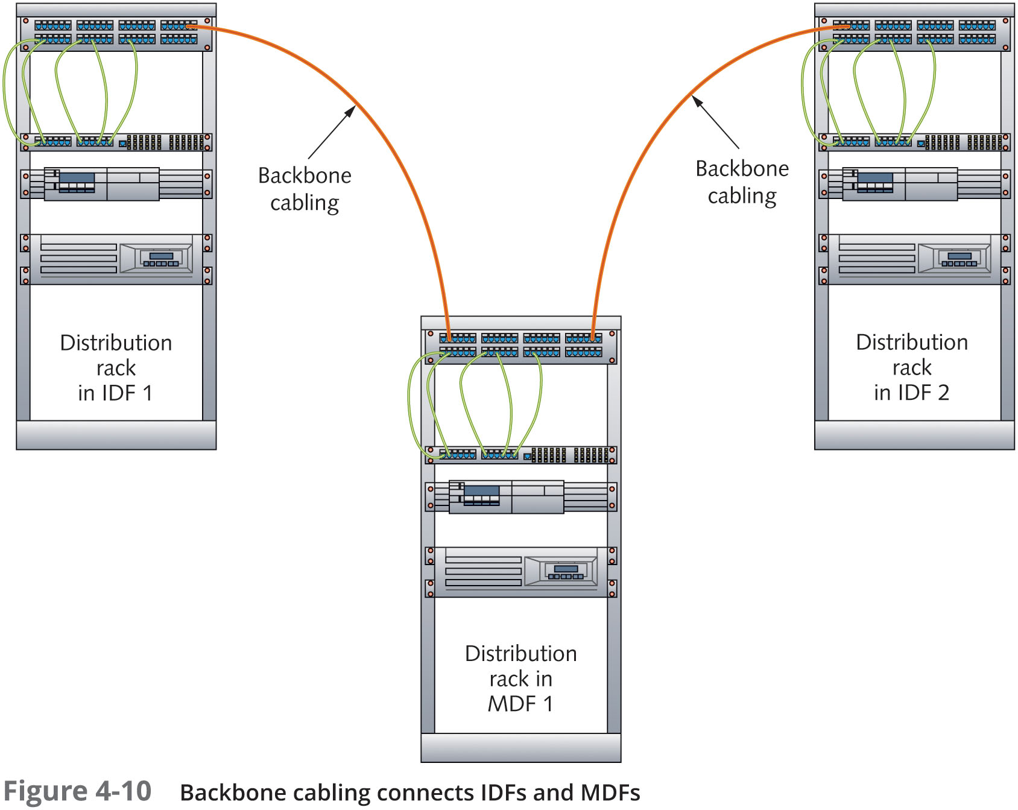
Structured Cabling: Managing and Installing a UTP Cable Plant

Slide 30
Structured Cabling: Managing and Installing a UTP Cable Plant
Installing UTP Cabling
Cable termination means putting RJ-45 plugs on the ends of cable or punching down wires into terminal blocks on a jack or patch panel
Some tools needed to create a patch panel and terminate cable:
Bulk UTP cabling
Wire cutters
Cable Stripper
Crimping Tool
Type 110 punchdown tool
Cable Tester
RJ-45 plugs/jacks and patch panel

Slide 31
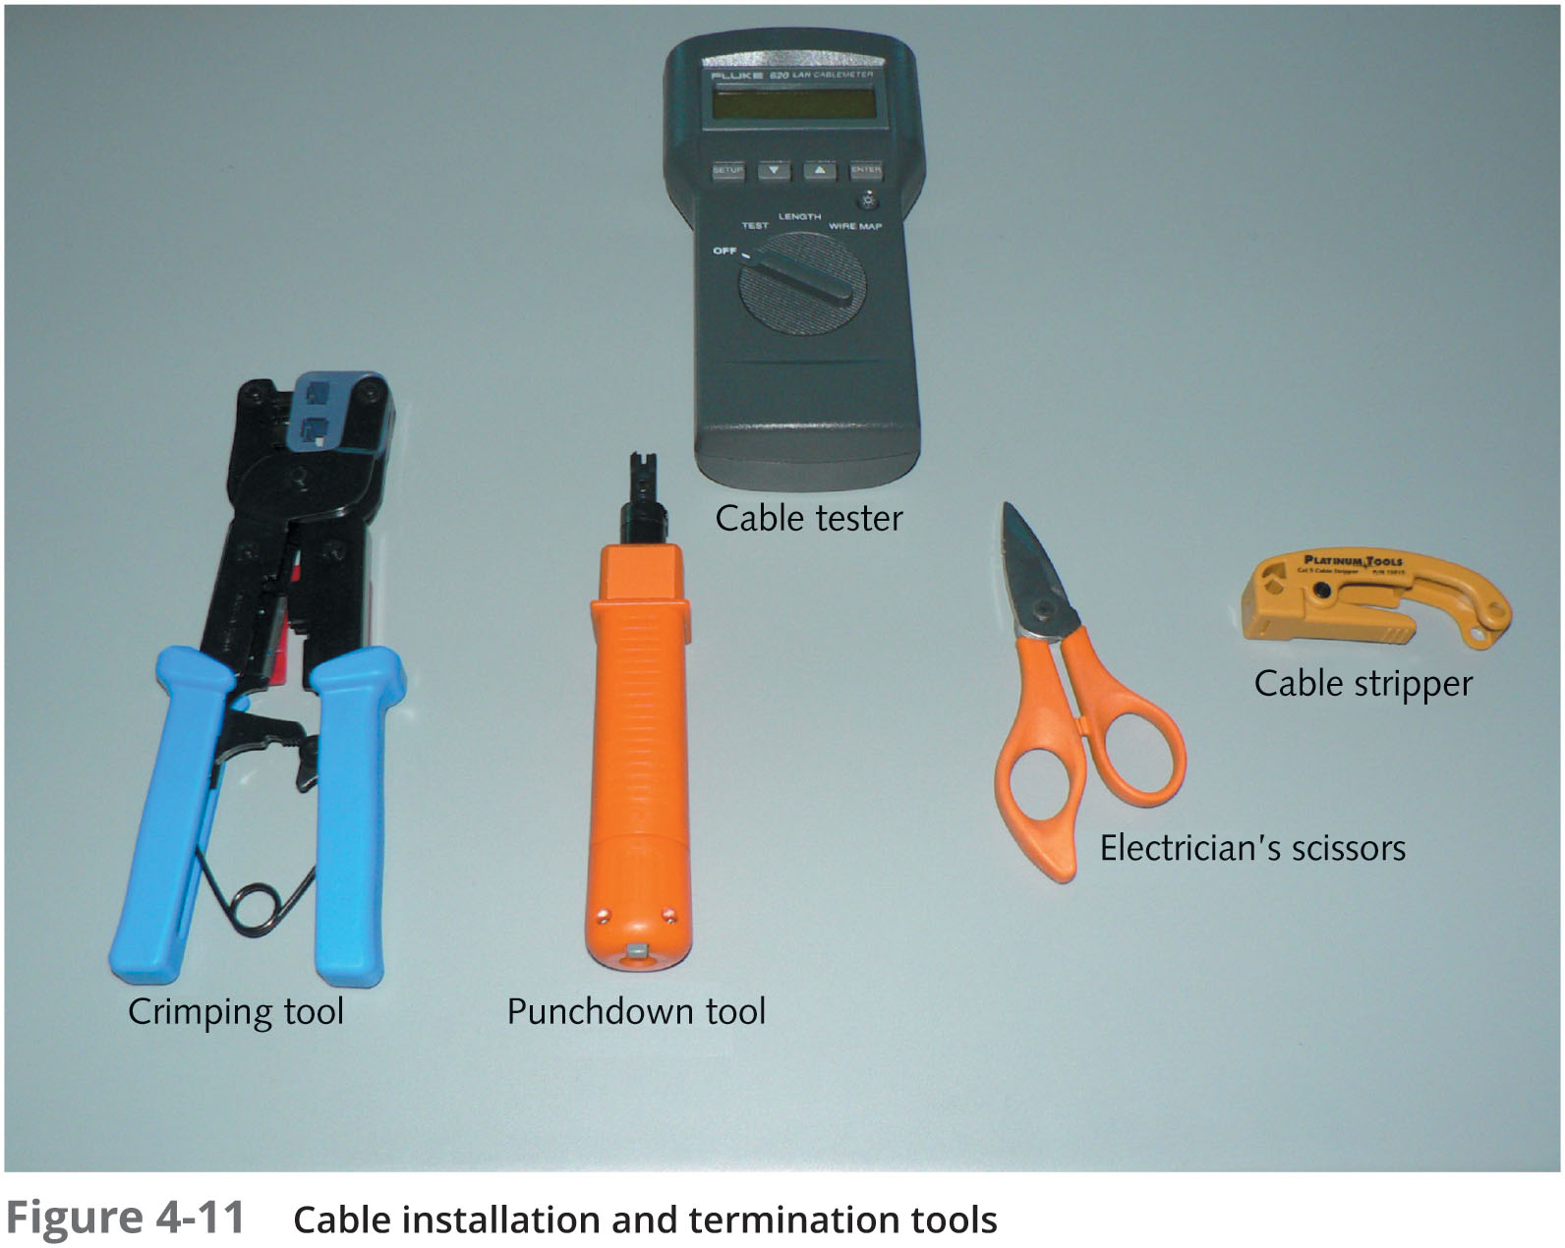
Structured Cabling: Managing and Installing a UTP Cable Plant

Slide 32
Structured Cabling: Managing and Installing a UTP Cable Plant
Installing UTP Cabling (continued)
When making a cable or terminating a cable at a jack or patch panel it is important to get the colored wires arranged in the correct order
There are two standards: TIA/EIA 568A and TIA/EIA 568B (see Figure 4-12 on the following slide)

Slide 33
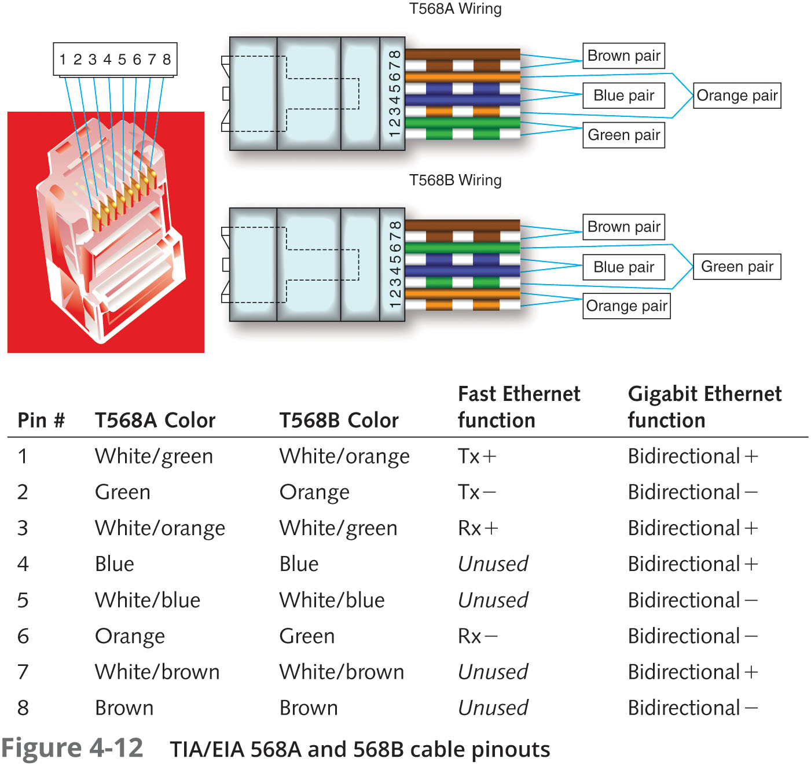
Structured Cabling: Managing and Installing a UTP Cable Plant

Slide 34
Structured Cabling: Managing and Installing a UTP Cable Plant
Straight-Through versus Crossover Cable
Standard patch cables are called straight-through cables (same wiring standard on both ends)
Crossover cables – use 568A standard on one side of the cable and 568B standard on the other side
Crosses the transmit and receive wires so that transmit on one end connects to receive on the other
This type of cable is often needed when you connect two devices of the same type to one another
For a 1000BaseT crossover cable, you have to cross the blue and brown pins because they’re used in 1000BaseT
The following slide shows the pinout for a 1000BaseT crossover cable

Slide 35
Structured Cabling: Managing and Installing a UTP Cable Plant
Pin | Connector 1 | Connector 2
1 | White with orange stripe | White with green stripe
2 | Orange | Green
3 | White with green stripe | White with orange stripe
4 | Blue | White with brown stripe
5 | White with blue stripe | Brown
6 | Green | Orange
7 | White with brown stripe | Blue
8 | Brown | White with blue stripe

Slide 36
Structured Cabling: Managing and Installing a UTP Cable Plant
Medium Dependent Interface
Network devices that connect by using RJ-45 plugs over twisted-pair cabling are classified as medium dependent interface (MDI) devices or MDI crossed (MDI-X) devices
MDI devices transmit on pins 1 and 2 and receive on pins 3 and 6
PC NICs and routers are examples
MDI-X devices receive on pins 1 and 2 and transmit on pins 3 and 6
Usually hubs and switches are examples
When two switches (or any other like devices) need to be connected, you use a crossover cable so that transmit and receive wires get crossed
Some devices have “auto-sensing” ports that can detect whether you are trying to connect transmit wires to transmit wires
The port can reconfigure transmit and receive wires, making a crossover cable unnecessary

Slide 37
Structured Cabling: Managing and Installing a UTP Cable Plant
Why Two Transmit and Two Receive Wires?
One wire pair is used for transmit (labeled transmit+/transmit-) and one pair for receive (labeled receive+/receive-)
The plus and minus symbols indicate that the wires carry a positive or a negative signal
This differential signal mitigates the effect of crosstalk and noise on the cable

Slide 38
Fiber-Optic Cable
With fiber-optic cable, bits are transmitted as pulses of light instead of electricity
Makes it immune to electrical interference
Fiber-optic cable is highly secure because electronic eavesdropping is eliminated
Composition of fiber-optic cable:
A slender cylinder of glass fiber called the core is surrounded by a concentric layer of glass called the cladding
Fiber is then jacketed in a thin transparent plastic material called the buffer
In most cases, each fiber-optic strand carries data in only one direction
Network connections typically consist of two or more strands

Slide 39
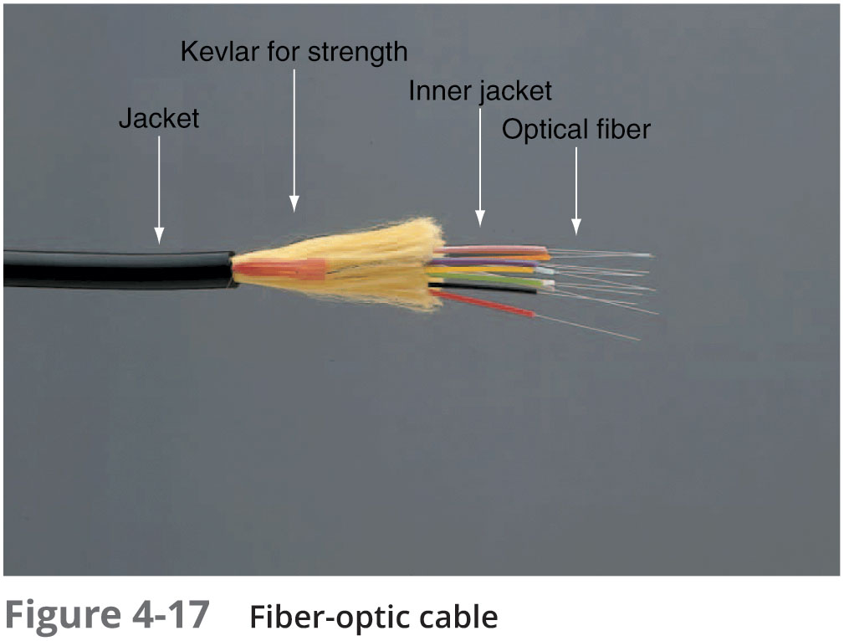
Fiber-Optic Cable

Slide 40
Fiber-Optic Cable
Fiber-optic cable used as backbone cabling often comes in bundles of 12 or more fiber strands
Even if you are only using 2 in the backbone, running more is a good idea so that you are ready for any future expansion
Some testing has shown that glass fibers can carry several terabits (1000 gigabits) per second
Fiber-optic cable may one day replace copper for all types of network connections
Table 4-5 on the following slide summarizes fiber-optic characteristics

Slide 41
Fiber-Optic Cable
Characteristic | Value
Maximum cable length | 2 km (6562 ft) to 100 km (62.14 miles)
Bandwidth | 10, 40, and 100 Gbps and higher
Bend radius | 30 degrees per foot
Installation and maintenance | Difficult to install and reroute; sensitive to strain and bending
Cost | Most expensive of all cabling options
Connector type | Several types (see bulleted list in the next section)
Security | Not susceptible to eavesdropping
Interference rating | None; least susceptible of all cable types

Slide 42
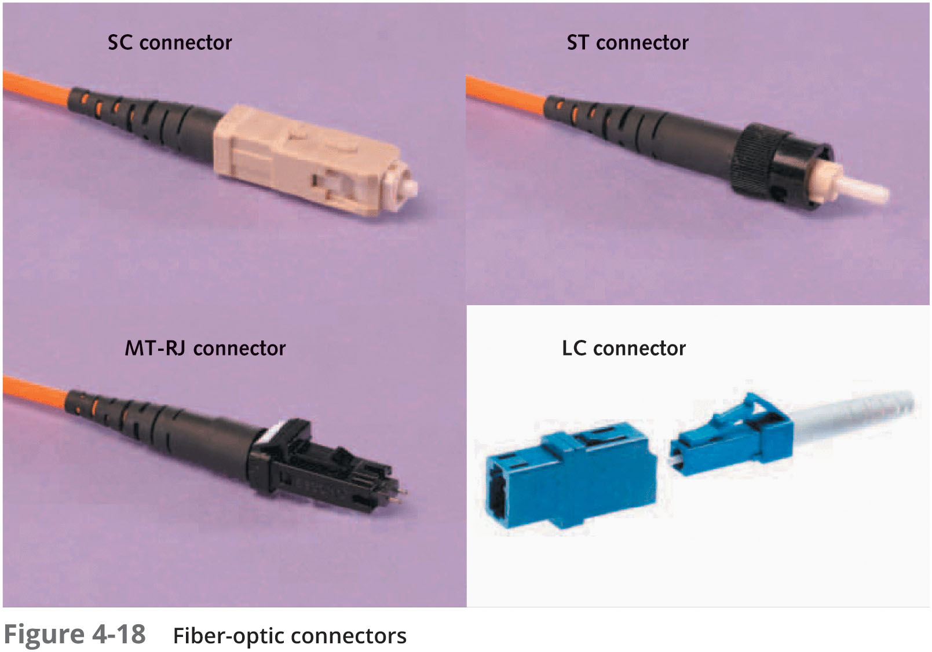
Fiber-Optic Connectors
Types of connectors:
Straight connection (SC)
Straight tip (ST)
Mechanical transfer registered jack (MT-RJ)
Locking connection (LC)
Fiber channel or ferrule connector (FC)
Medium interface connector (MIC)
Subminiature type A (SMA)

Slide 43
Fiber-Optic Installation
Installing fiber-optic networks is more difficult than installing copper media
However, advances in connector technology are closing the gap
Connectors and test equipment required for termination are still more expensive than copper
There are many methods for terminating fiber-optic cables because of the many connectors and cable types available
Installation details are beyond the scope of this book
Some tools in a typical fiber-optic termination kit include:
Buffer tube stripper and cable stripper
Crimper
Diamond cleaver
Inspection scope
Polishing tool

Slide 44
Fiber-Optic Cable Types
Single-mode fiber (SMF):
Includes a single, small-diameter fiber at the core (8 microns)
Generally works with laser-based emitters
Spans the longest distances
Used in higher-bandwidth applications
Multimode fiber (MMF) :
Larger diameter fiber at the core (50 and 62.5 microns)
Costs less than SMF
Works with lower-power light emitting diodes (LEDs)
Spans shorter distances

Slide 45
Cable-Testing Equipment
Common tools for testing and troubleshooting wired networks:
Cable certifier
Basic cable tester
Tone generator
Time domain reflectometer (TDR)
Multimeter
Optical power meter (OPM)

Slide 46
Wireless Networking
Demand for wireless networking has increased considerably
Production of wireless equipment has increased, which brings prices down
Wireless networks are often used with wired networks to interconnect geographically dispersed LANs or groups of mobile users with wired servers and resources on a wired LAN (sometimes referred to as “hybrid networks”)
Even in small networks with workstations connecting to a wireless AP or router, the AP or router usually connects to the Internet via a wired connection to a cable modem

Slide 47
Wireless Benefits
Wireless networking can offer the following capabilities:
Create temporary connections to wired networks
Establish backup or contingency connectivity for existing wired networks
Extend a network’s span beyond the reach of wire-based or fiber-optic cabling, especially in older buildings where rewiring might be too expensive
Allow businesses to provide customers with wireless networking easily, offering a service that gets customers in and keeps them there
Enable users to roam around an organization or college campus with their devices

Slide 48
Wireless Benefits
Common applications for wireless networking technologies include:
Ready access to data for mobile workers
Delivering network access to isolated facilities or disaster-stricken areas
Access in environments where layout and settings change constantly
Improved customer services in busy areas, such as check-in or reception centers
Network connectivity in structures where in-wall wiring is impossible to install or prohibitively expensive
Home networks where running cables is inconvenient

Slide 49
Types of Wireless Networks
Wireless networks can be subdivided into the following categories:
Local area networks (LANs) – usually provides connectivity for mobile users or across areas that couldn’t otherwise be networked
Extended LANs – usually used to increase a LAN’s span beyond normal distance limitations
Internet service – used to bring Internet access to homes and businesses
Mobile computing – users communicate by using a wireless networking medium that enable them to move while remaining connected to a network

Slide 50
Wireless LAN Components
The wireless components of most LANs behave like their wired counterparts
Network interface attaches to an antenna and an emitter rather than to a cable
Transceiver or an access point (AP) is a transmitter/receiver device that must be installed to translate between wired and wireless networks
Includes an antenna and a transmitter to send and receive wireless traffic but also connects to the wired side of the network
Shuttles traffic back and forth between a network’s wired and wireless sides

Slide 51
Wireless LAN Transmission
Wireless communications depends on sending and receiving signals broadcast through the air to carry information
These signals take the form of waves in the electromagnetic (EM) spectrum
The frequency of the wave forms used for communication is measured in cycles per second, usually expressed as hertz (Hz)
Lower-frequency transmissions can carry less data more slowly over longer distances, and higher-frequency transmissions can carry more data faster over shorter distances
The following are the most common frequencies for wireless data communication:
Radio – 10 KHz to 300 MHz
Microwave – 300 MHz to 300 GHz
Infrared – 300 GHz to 400 THz (terahertz)

Slide 52
Wireless LAN Transmission
Wireless LANs make use of four primary technologies for transmitting and receiving data
Infrared
Laser
Narrowband (single-frequency) radio
Spread-spectrum radio

Slide 53
Wireless LAN Transmission
Infrared LAN Technologies
Infrared (IR) wireless networks use infrared light beams to send signals between pairs of devices
IR works well for LAN applications due to high bandwidth
Four main kinds of infrared LANs include:
Line-of-sight networks require an unobstructed view between transmitter and receiver
Reflective wireless networks broadcast signals from optical transceivers near devices to a central hub
Scatter infrared networks bounce transmissions off walls and ceilings to deliver signals
Broadband optical telepoint networks provide broadband services

Slide 54
Wireless LAN Transmission
Laser-Based LAN Technologies
Laser-based transmissions also require a clear line of sight between sender and receiver
Laser-based LAN devices are subject to many of the same limitations as infrared
Aren’t as susceptible to interference from visible light sources as infrared
Narrowband Radio LAN Technologies
Use low-powered, two-way radio communication
The receiver and transmitter must be tuned to the same frequency Requires no line of sight between sender and receiver as long as both parties stay within the broadcast range of these devices
Typically 70 meters or 230 feet
Depending on the frequency, walls or other solid barriers can block signals
Interference from other radio sources is possible
Table 4-6 (see next slide) displays narrowband wireless LAN characteristics

Slide 55
Wireless LAN Transmission
Characteristic | Value
Frequency ranges | Unregulated: 902-928 MHz, 2.4 GHz, 5.72-5.85 GHz
Maximum distance | 50-70 m (164-230 ft)
Bandwidth | 1-10 Mbps
Installation and maintenance | Easy to install and maintain
Interference | Highly susceptible
Cost | Moderate
Security | Highly susceptible to eavesdropping within range

Slide 56
Wireless LAN Transmission
Spread-Spectrum LAN Technologies
Spread-spectrum uses multiple frequencies simultaneously, improving reliability and reducing susceptibility to interference
Also makes eavesdropping more difficult
Two main kinds of spread-spectrum communications:
Frequency hopping – switches data between multiple frequencies at regular intervals
Direct-sequence modulation – breaks data into fixed-size segments called chips and transmits the data on several different frequencies at the same time
Table 4-8 on the following slide displays spread-spectrum LAN characteristics

Slide 57
Wireless LAN Transmission
Characteristic | Value
Frequency ranges | Unregulated: 902-928 MHz or 2.4 GHz, 5 GHz
Maximum distance | Limited to cell boundaries but often extends over several miles
Bandwidth | 1-2 Mbps for frequency hopping, 2-6 Mbps for direct-sequence modulation
Installation and maintenance | Depends on equipment; ranges from easy to difficult
Interference | Moderately resistant
Cost | Inexpensive to moderate
Security | Not very susceptible to eavesdropping

Slide 58
LAN Media Selection Criteria
In LANs, there are three main media choices: UTP, fiber-optic, and wireless
When choosing between media types, consider:
Bandwidth – Higher bandwidth means more expensive cable and higher installation costs
If 40 Gbps or more, fiber-optic is the only choice
Budget – A typical UTP cable installation cost $100 - $200 per cable run and fiber-optic might cost twice that much
Wireless have no physical installation costs but you need to install access points and verify connectivity
Environmental considerations – How electrically noisy is the environment? How important is data security?
The more weight either factor has, the more likely fiber-optic or secured wireless is the right choice

Slide 59
LAN Media Selection Criteria
When choosing between media types, consider (continued):
Span – What kind of distance must the network span?
Longer spans might require fiber-optic or wireless be used between buildings
Strategic placement of small switches or hubs gives UTP surprising reach
Existing cable plant – For an upgrade, the existing cable plant must be considered
Table 4-9 on the following slide condenses the most important information for the cable types covered in this chapter

Slide 60
LAN Media Selection Criteria
Type | Maximum cable length | Bandwidth | Installation | Interference | Cost
UTP | 100 m | 10-10,000 Mbps | Easy | High | Cheapest
STP | 100 m | 16-10,000 Mbps | Moderate | Moderate | Moderate
Fiber optic | 2-100 km | 100 Mbps-10 Gbps | Moderate | None | Most expensive
Wireless | 100-300 ft | 11-300 Mbps | Easy | Moderate | None for physical media

Slide 61
Summary
Wired networking media come in two primary categories: copper and fiber-optic
Twisted pair cabling comes in shielded or unshielded varieties
Most use UTP, but STP can be used in electrically noisy environments
Twisted pair cabling components consist of connectors, patch cable, jacks, patch panels and distribution racks
A structured cabling plant consists of work areas, horizontal wiring, telecommunications closets (IDFs), equipment rooms (MDFs), backbone cabling, and entrance facilities
Fiber-optic uses pulses of light to represent bits and is immune to EMI, RFI and electronic eavesdropping

Slide 62
Summary
Wireless networks can be subdivided into LANs, extended LANs, and mobile computing
Components of a wireless LAN are a NIC, an antenna, and a transceiver or access point
Technologies used to transmit and receive data including: infrared, laser, narrowband radio and spread-spectrum radio
Criteria for choosing LAN media include needed bandwidth, budget, environmental factors, the distance the network must span, and the existing cable plant
Networks combining fiber-optic, UTP, and wireless have become the norm

